Slide 1

QORVO_RADIO
Prototype Review Presentation
04/07/2025
Andrew Nicola, Nathan Waters, Andrew Bowman, Alan Luecke, Steve Freinstein
Notes:
Introduce entire team

Slide 2

Objective
Primary goal
Design and Develop a modular, reconfigurable Software Defined Radio (SDR) platform that can accommodate future student projects and provide a flexible environment
Key Functionality
Enable testing of multiple RF modules simultaneously with an independent digital control
Support a frequency range of 85 MHz to 2500 MHz with dual receive (Rx) channels
Ensure interaction between hardware and software through an Ethernet/USB interface
Information from [C] Statement of Work
Notes:
Go over SOW/ what we are doing for project

Slide 3
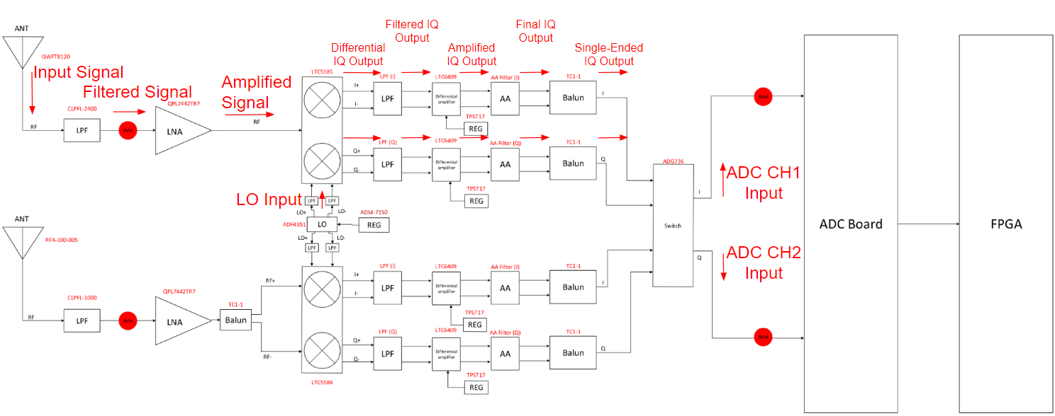
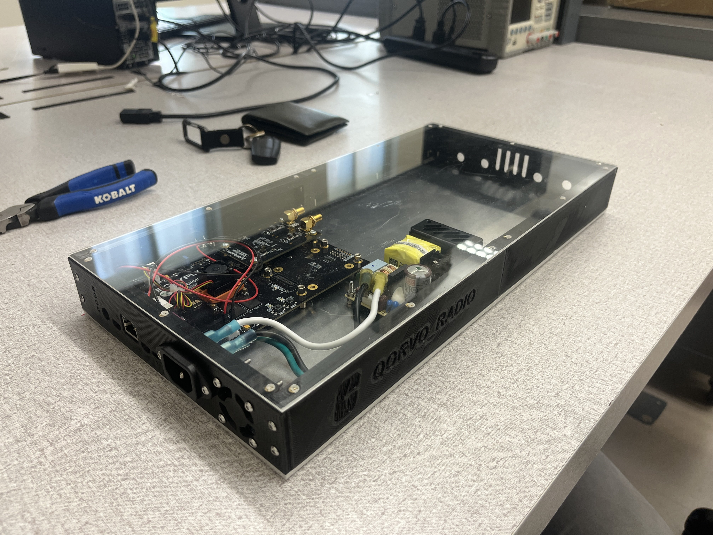
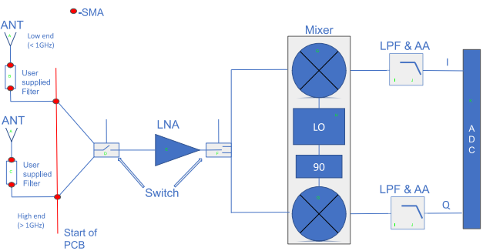
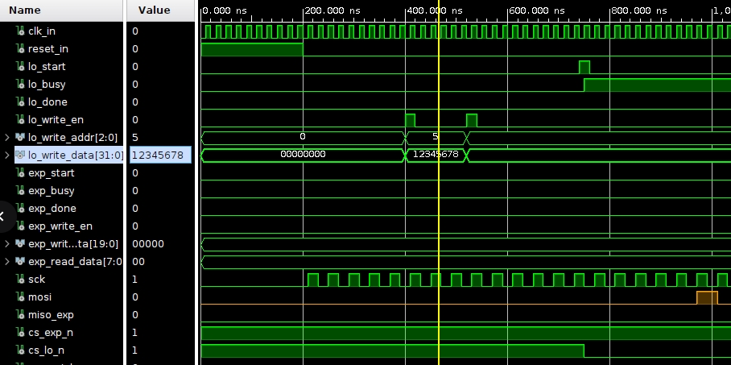
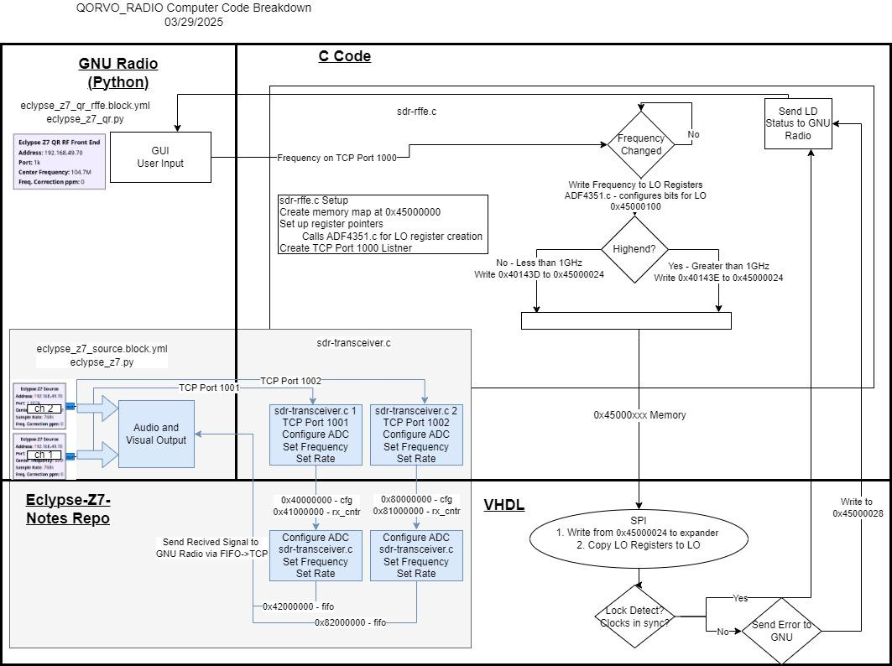
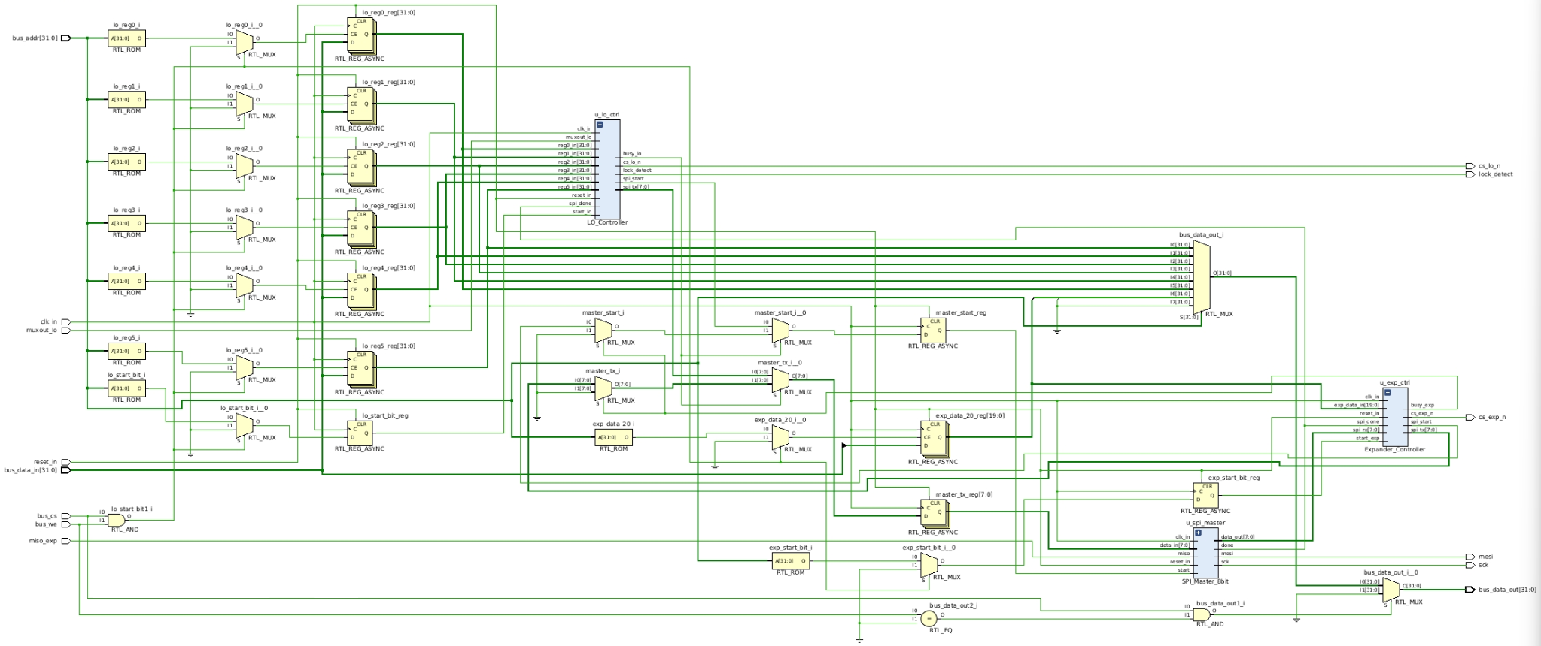
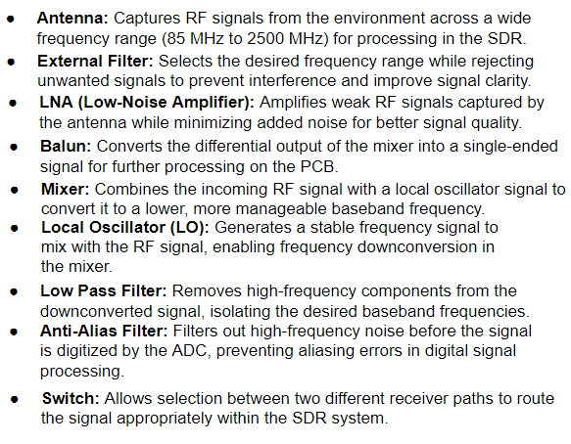
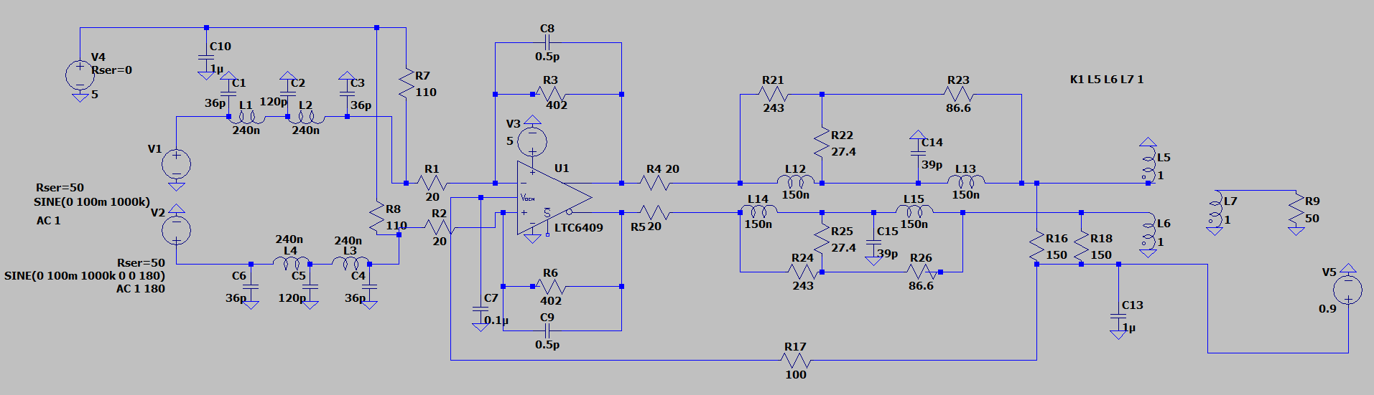
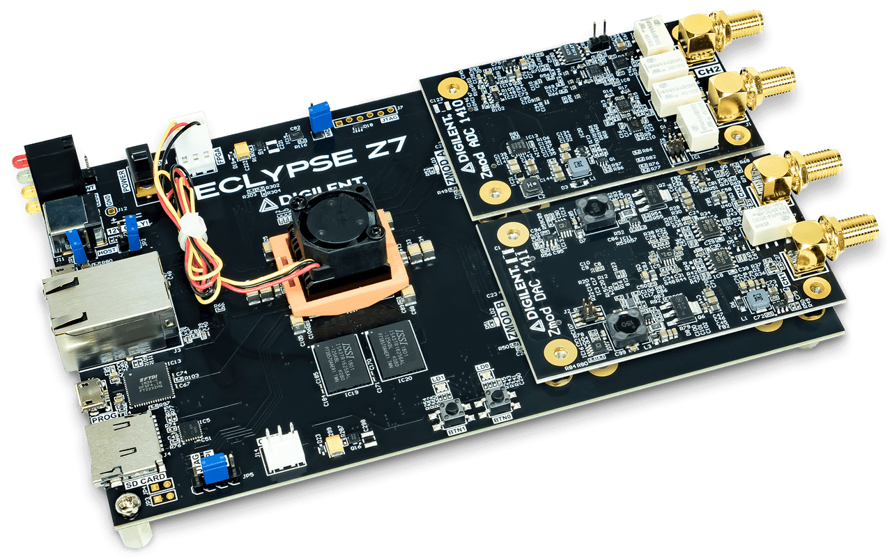
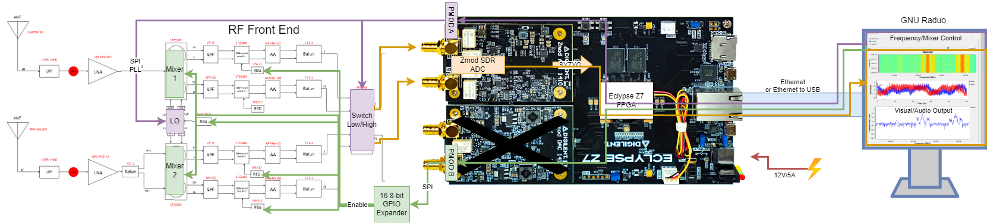
Project Overview
RF Front End
Direct Conversion
2 Paths
Component Selection
Filtering Simulations
FPGA
Simulated Controls
Pluto
Testing on Flipper
Clock Outputs
ENCLOSURE
Manufacturing
Assembly
Notes:
RF front end
Go over type of radio (direct conversion)
2 Rx paths
Talk about meeting where they showed the original block diagram
Component selection (Nicola)
Filtering (Nicola)
FPGA
Enclosure
Talk about fitting in server rack
Enough space for next project
Visible/accessible to anyone who has it (glass top and removable)

Slide 4
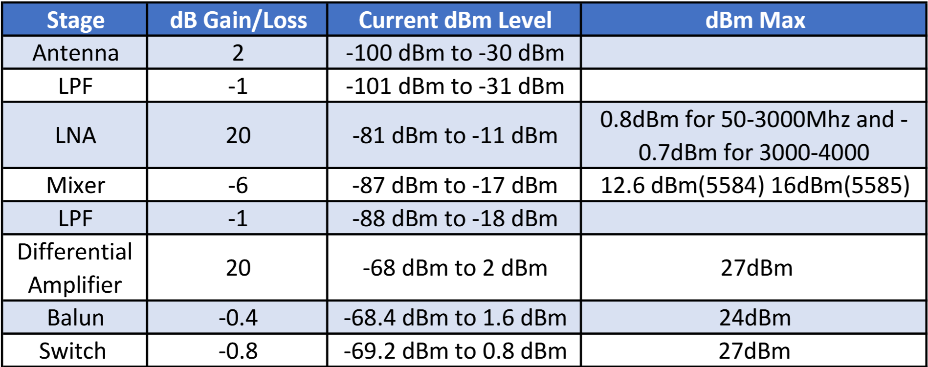
Signal Chain Analysis
Signal Chain Gain Distribution: The LNA and Differential Amplifier provide significant gain stages, each contributing +20 dB, boosting signal strength from -81 dBm to -11 dBm after the LNA, and from -68 dBm to 2 dBm after the Differential Amplifier.
Power Handling Thresholds: The LNA is limited to a maximum of 0.8 dBm for frequencies between 50-3000 MHz and 0.7 dBm for 3000-4000 MHz. The mixer (LTC5585) can handle up to 16 dBm, and the Differential Amplifier has the highest tolerance with a maximum of 27 dBm.
Cumulative Losses: Signal degradation occurs through low-pass filters, the mixer, the balun, and the switch, with a total insertion loss of approximately 9.2 dB before reaching the Differential Amplifier.
Notes:
-100dBm was found by using the pluto to listen to local FM

Slide 5
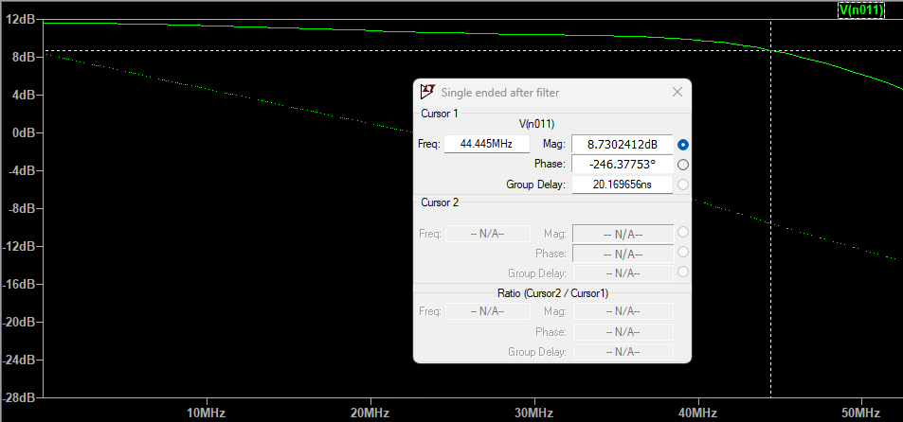
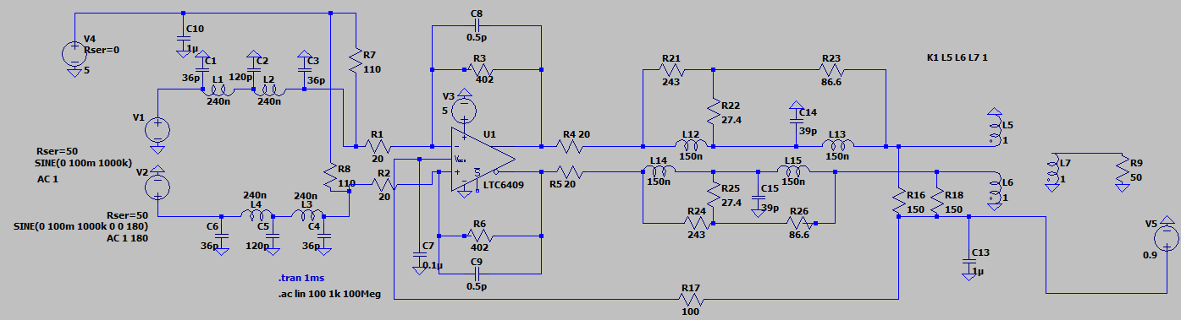
Filter Simulation
Initially, filter designs were pulled from relevant application circuits or designed using the MarkiCircuits filter designer tool.
Filters were then simulated in LTspice to verify operational accuracy.
Using LTspice we would make edits to the component values to reach the desired cutoff frequency.
Some component values were changed during the ordering process due to lack of stock or the value not being standard, LTspice was used to simulate the substitute values.
Notes:
Filtering for I/Q channel was pulled from Mixers datasheets and fine tweaked to fit our need
LPF for LO outputs were designed from marki circuit which we had to change further into the design to cover the full bandwidth of the IC to make sure our signal was not cut off
Simulating the full filters (with balun) was not able to be done because the balun did not include a loss for simulations, but since it is 1:1, it should not cause too big of an issue.

Slide 6
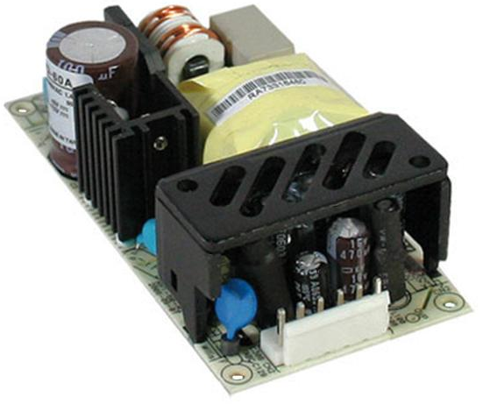
Power Supply
Purchased the RPD-60A medical grade switching power supply with 5V and 12V outputs, rated for 50W and has a 100 kHz Frequency of oscillation.
For voltage values that differ than 5V and 12V linear regulators were used.
We are currently in the process of making two power supply related cables:
One will be from the power supply to the enclosure.
One will be from the enclosure to the wall.
Notes:
Dive into lower

Slide 7
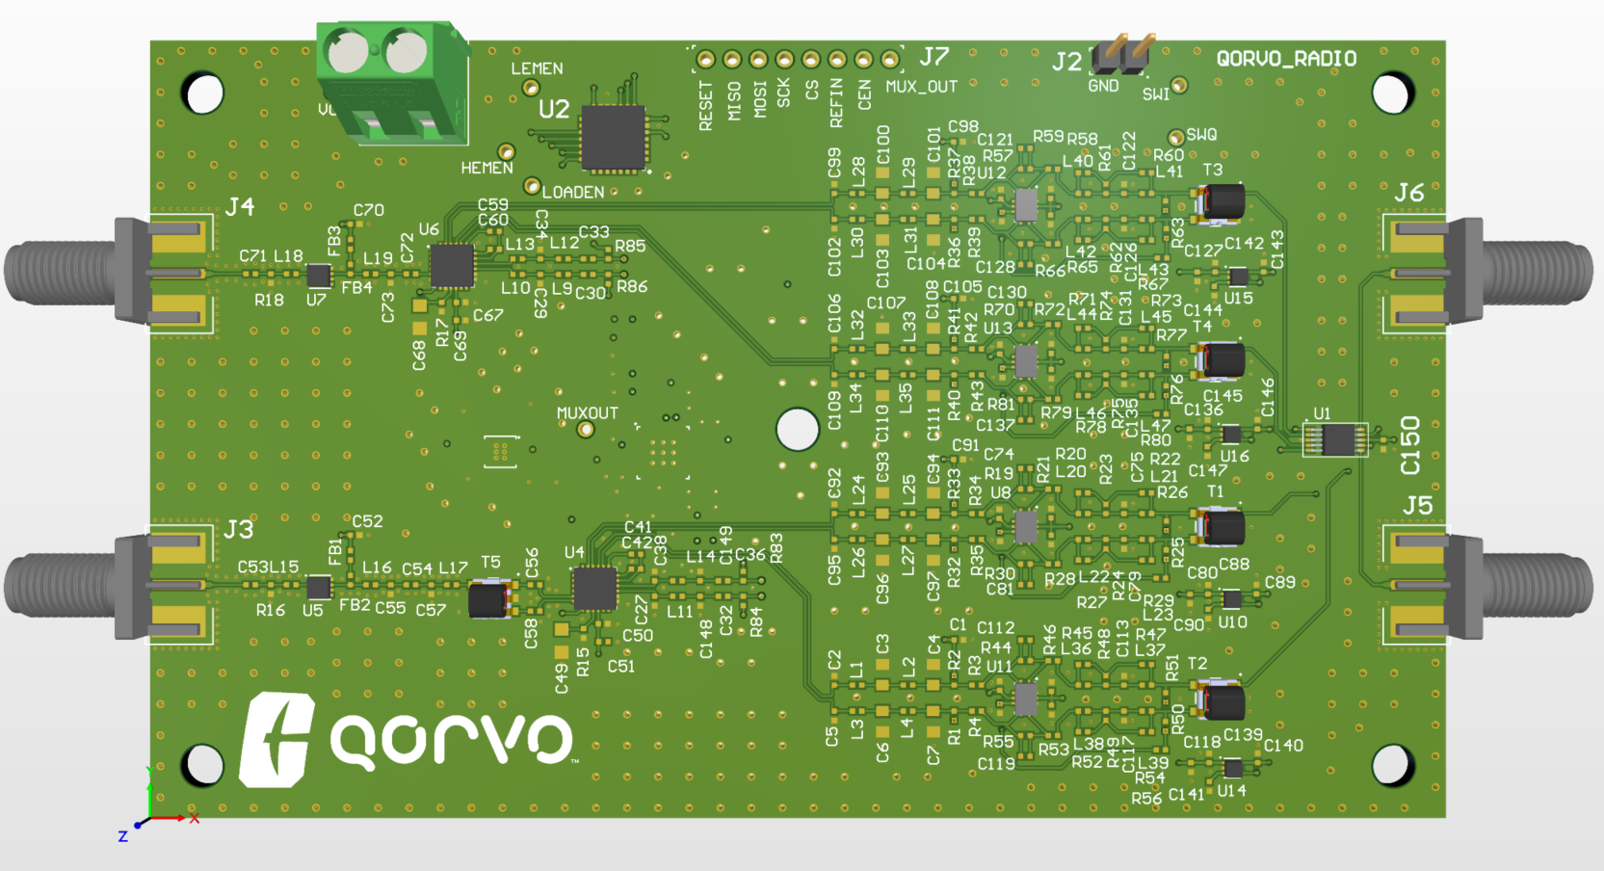
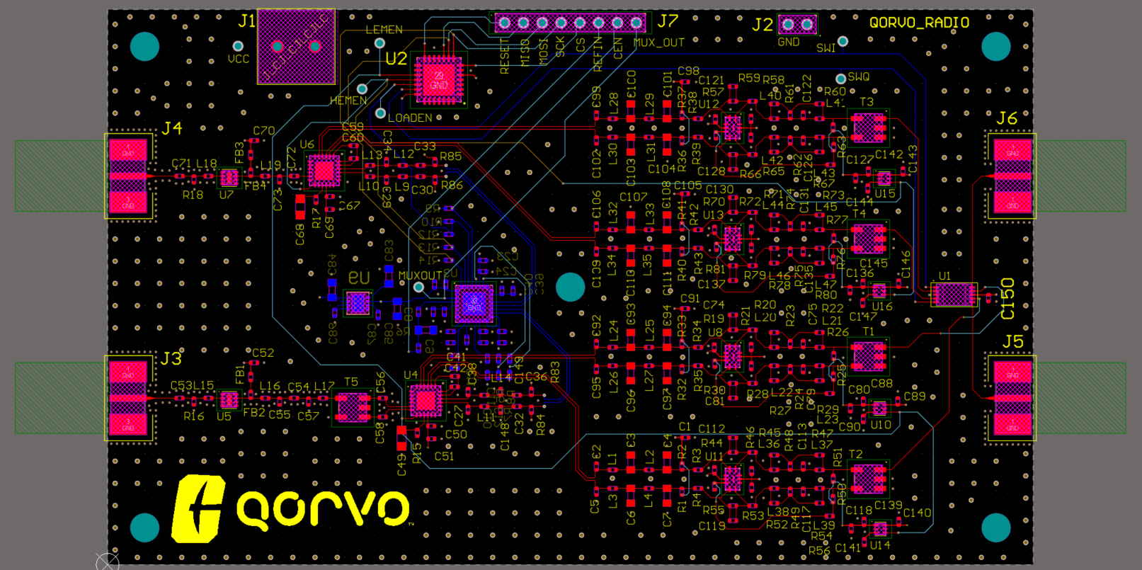
PCB 3D Model
Notes:
Final Layout
Traces calculated using Manu calculator (JLC)
2 Rx paths
High/Low end
Where muxout is, our LO is on the other side of the board
Outputs for LO come out at R83-86
Going into filtering is differential
Filtering components are spaced out to try and keep it as close as possible in length
At the end is our switch
Test points
Stitching vias
Shielding Vias
Mounting holes
Control header at top
GND test header

Slide 8
Abstracted Data Path [G] [P1.1, 1.6]
Notes:
Go over SOW/ what we are doing for project

Slide 9
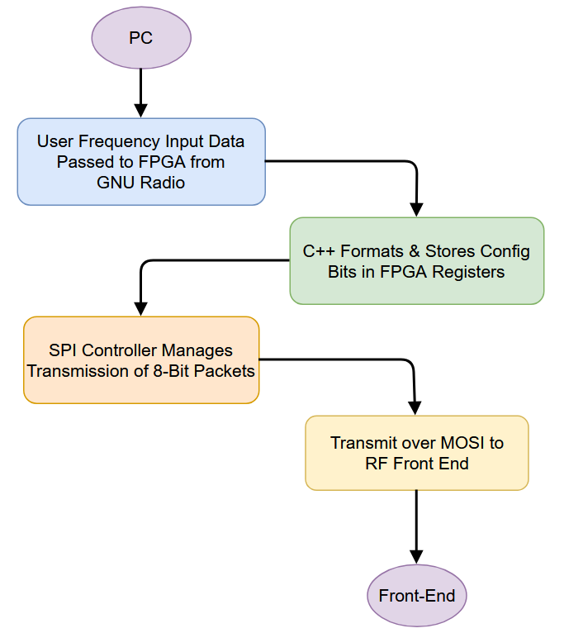
FPGA & Control Logic Analysis
Wrote C++ to process user frequency input
Pass user-defined frequency captured by GNU Radio.
Register values are calculated for desired LO frequency.
Output dividers and fractional/integer-N modes are automatically selected.
6 x 32-bit register values (R0–R5) are produced for SPI transfer.
Formatted register values are returned for LO chip configuration.
Wrote VHDL to interpret and transmit control data via SPI
SPI logic developed entirely in VHDL.
Bit-accurate communication with RF front-end components.
Supports register-level configuration of LO and peripheral chips.
Verified functionality via Vivado simulations and Flipper Zero.
Notes:
Go over SOW/ what we are doing for project

Slide 10
GNU Radio/PC/ADC Communication
Notes:
Go over SOW/ what we are doing for project

Slide 11
Custom VHDL SPI Manager
Notes:
Go over SOW/ what we are doing for project

Slide 12
Designed for Reusability and Handoff
Hardware and Software Flexibility
FPGA and front-end are independently swappable
Adaptable SPI framework supports any compatible RF component
Designed to scale with future channels, frequencies, and features
Codebase and System Design
Code written in reusable, testable modules (C++ and VHDL)
SPI logic and register handling easily portable to other platforms
Clean memory map and logic separation aid future debugging
Documentation and Student Support (Work in Progress)
Full documentation and commenting, provided for future developers
Includes flowcharts, memory maps, usage examples, and config steps
Platform encourages hands-on exploration of SDR, VHDL, embedded systems
Notes:
Go over SOW/ what we are doing for project

Slide 13
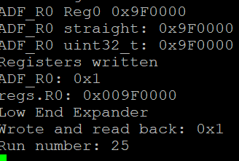
Completed Testing and Validation
PC-to-FPGA Communication:
Verified GNU Radio can send data packets to the FPGA.
SPI Simulation Testing (Vivado):
Simulated bitstreams matched expected values.
Waveforms confirmed correct timing and logic.
RTL diagram confirmed correct data flow structure.
Physical Testing (Flipper Zero in progress):
Confirmed correct SPI output from the FPGA, based on user input.
Notes:
Go over SOW/ what we are doing for project

Slide 14
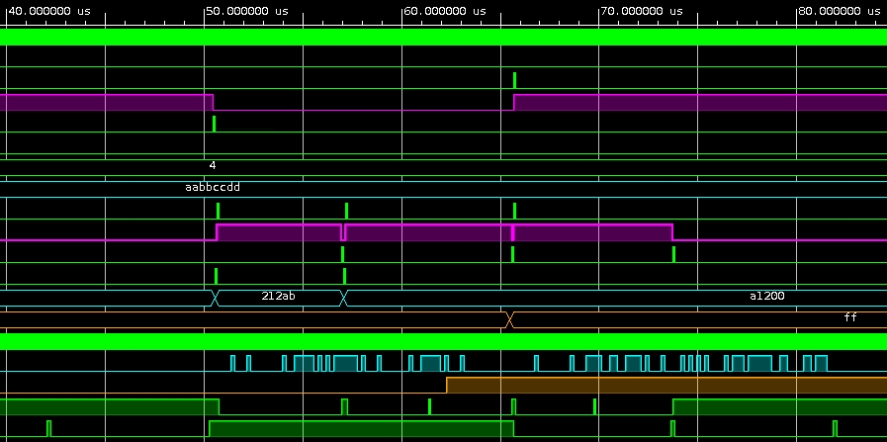
Test Plan Before Front-End Integration
Challenge: RF Front-End PCB delays reduce testing time after arrival.
Key Pre-Integration Tests:
Heavy simulation and modular testing in place of full system tests
Ensure correct register bit configuration for front-end components
Chip Enables
Switching
Ensure consistent formatting of config packets from PC to FPGA.
Goal: Ensure end-to-end signal chain (GUI → SPI output) is fully debugged.
Mitigation Strategy:
Simulate and verify every subsystem independently.
Confirm SPI logic and register formatting to reduce risk during integration.
Plan for rapid final testing using pre prepared configuration test scripts.
Notes:
Go over SOW/ what we are doing for project

Slide 15
Contingency Plan
If the custom SDR receiver module fails or underperforms, the Analog Devices ADALM-Pluto (Pluto SDR) will be used as the receiver. The Pluto SDR provides:
Reliable performance within the desired frequency range (70 MHz to 6 GHz).
Sufficient bandwidth (up to 20 MHz) for testing and validation.
Compatibility with existing tools and frameworks (GNU Radio, MATLAB, Python).
Cost-effective and readily available solution to maintain progress on the project.
Will be able to show all required
We were able to stress test this set up by having it listen to FM radio for an hour, there were no issues faced during this test.
Notes:
Go over SOW/ what we are doing for project

Slide 16
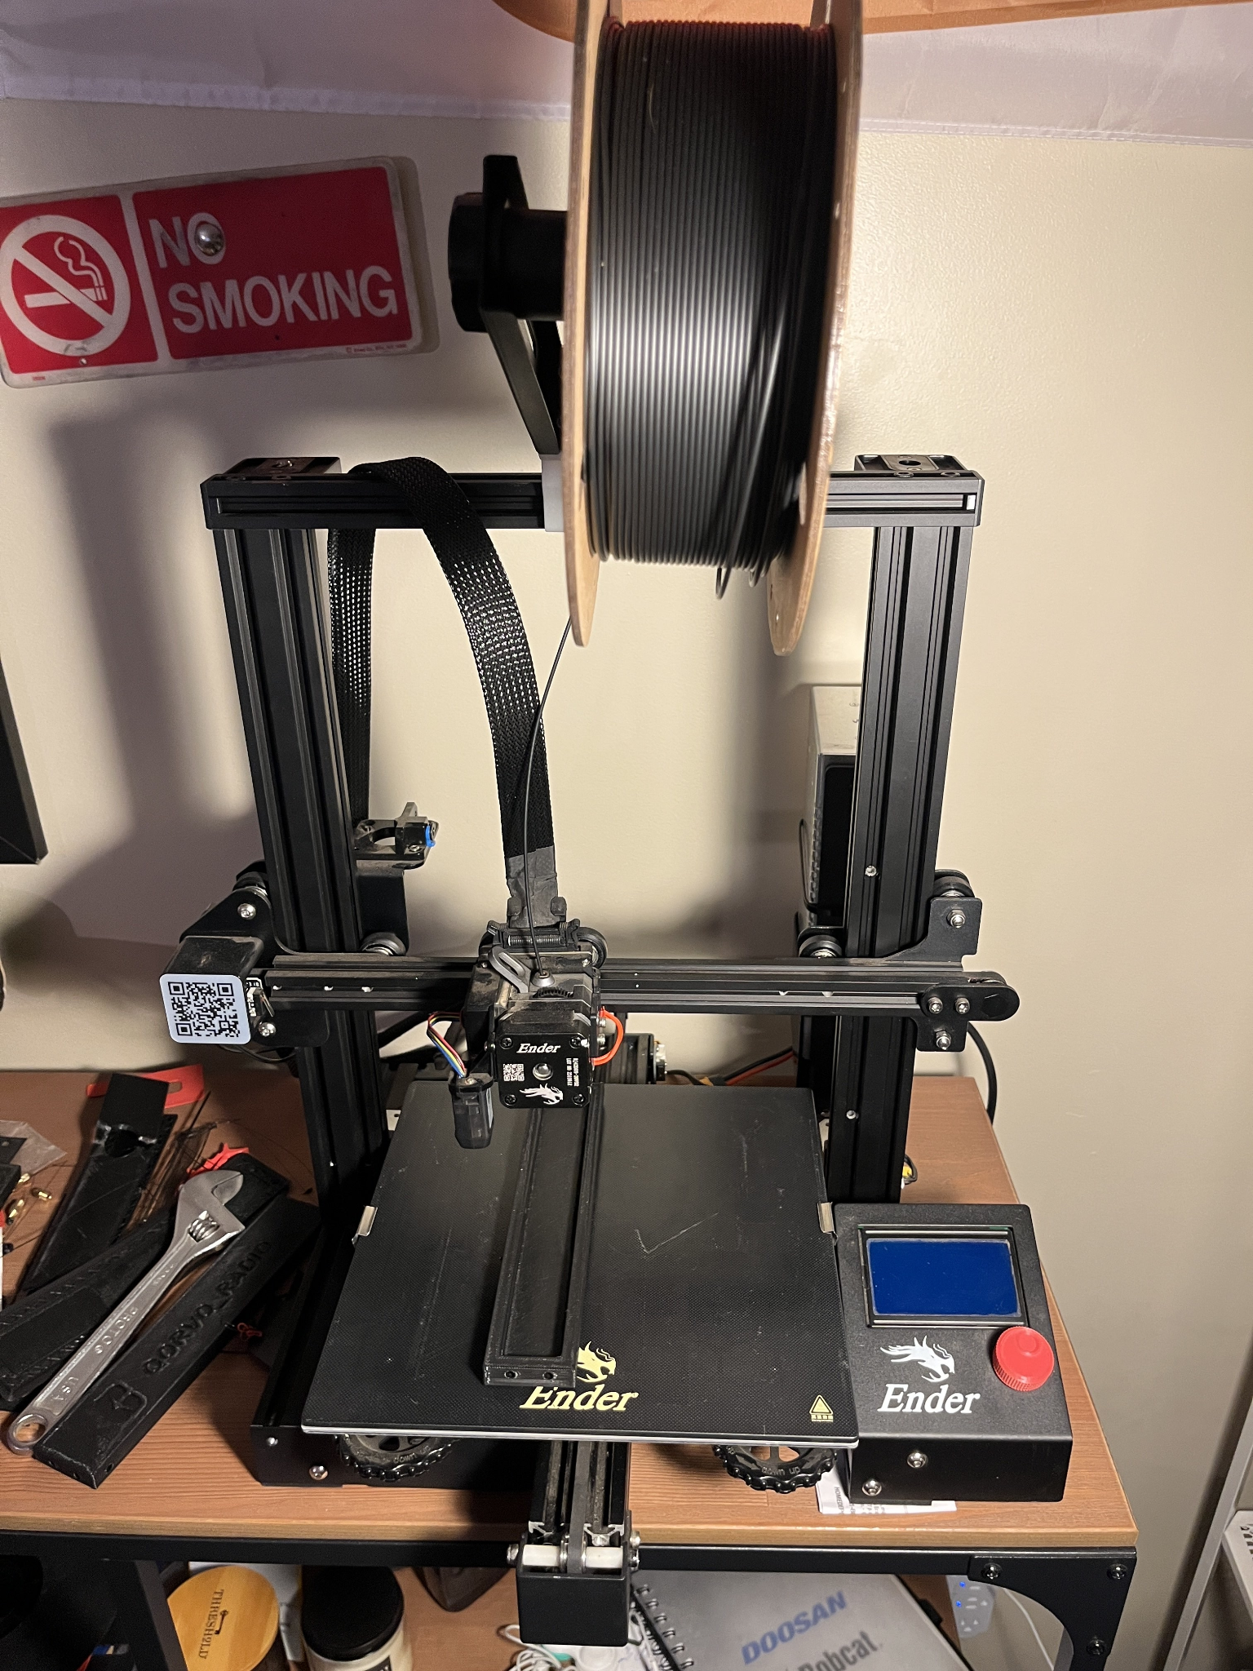
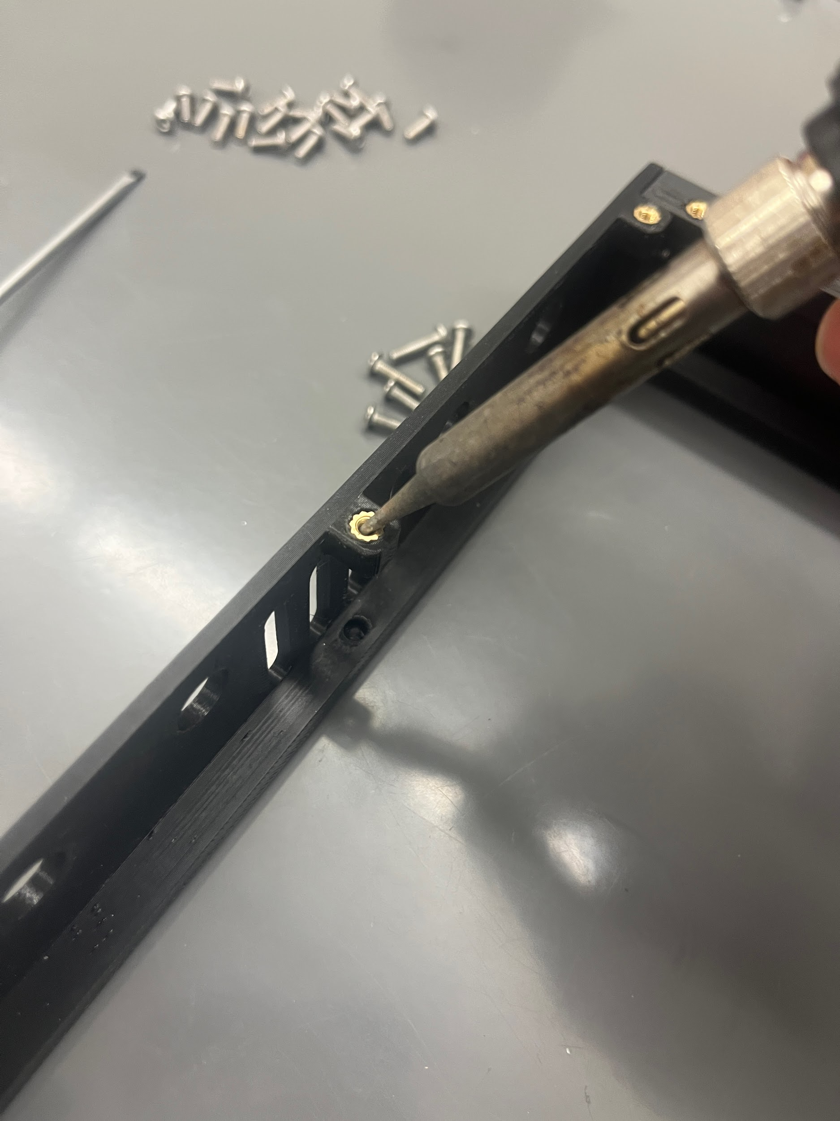
Mechanical Overview
3D printed walls - pla+
Aluminum base plate
Plexiglass lid for visibility
Threaded inserts for assembly
Integrated user interface
Fan and switch attached to walls
FPGA, PS, and PCB mounted to enclosure

Slide 17
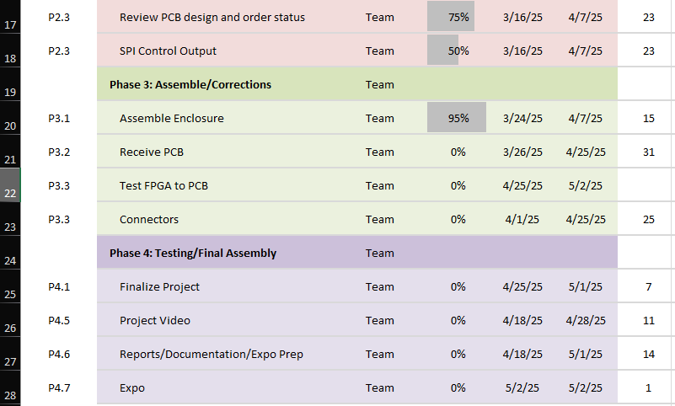
Project Plan and Outstanding Milestones
Notes:
Will go over purchasing issues in later slide
Assembly for enclosure almost done (Missing PCB)
Computers (need to fill in)

Slide 18
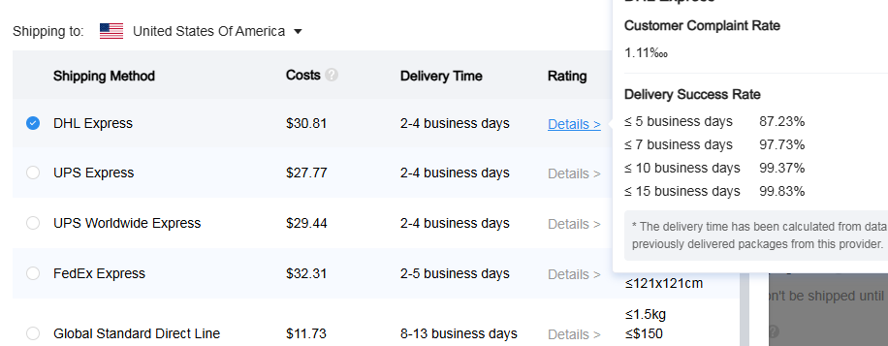
Purchasing Status
PCB
PCB pre-order parts: JLC has to receive parts before building
PCB manufacture and Assembly: Ready to order, waiting on JLC (still 4/7)
Build time: 7-10 days
Shipping: 2-4 business days, (see screenshot)
PCB will cost in total $562.64
Allocation of rest of budget ($1582.15)
Trip to Qorvo ~ $235
Waveform generator (AWG)
VNA
(Tools for next Senior Design Project)
Notes:
PCB-
Pre-order parts, made adjustment to parts that were going to take too long to receive
PCB manu and Assembly: All files, Pick and place, BOM, build in JLC, Gerber files are all ready to go
Allocation of the rest of budget
Decided in 4/2 meeting

Slide 19
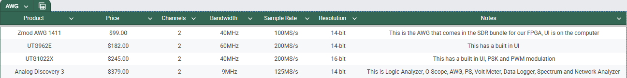
Waveform Generator
$409.00
13MHz with DNC connector
VNA

Slide 20
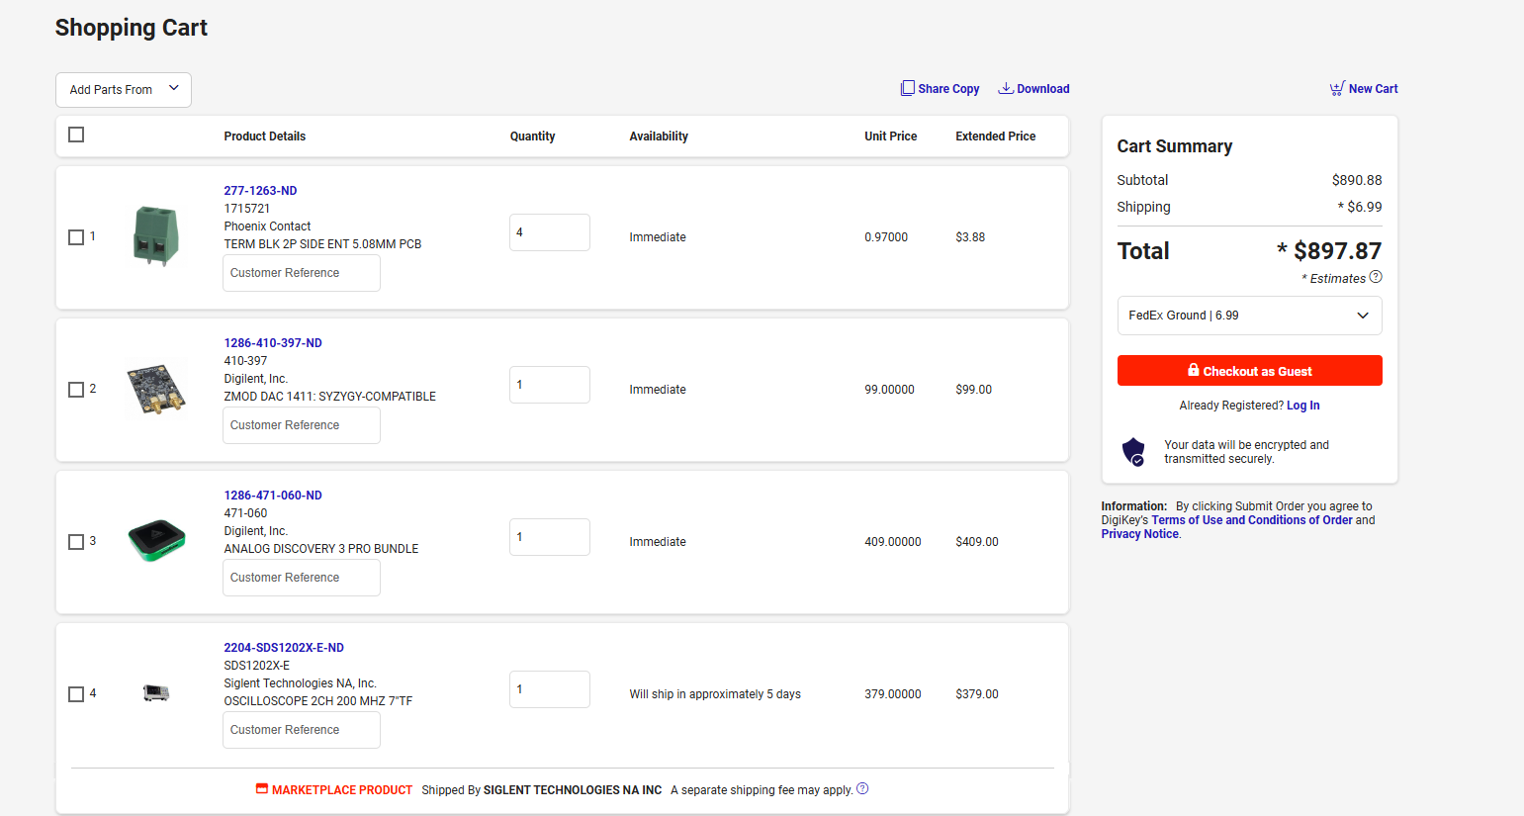
This will leave $449.28 left over in our budget

Slide 21
Impact
Cultural Impact: Encourages mentorship and collaboration among engineering students, fostering a more interdisciplinary learning environment. This initiative can help diversify Charlotte’s engineering culture, which has been traditionally power-focused, by expanding the school's expertise to include RF systems and other related fields
Social Impact: Expands access to hands-on RF learning experiences at Charlotte, increasing the number of students interested in this field. This heightened interest will lead to a broader, more diverse student body with enhanced RF knowledge and skills.
Environmental Impact: Reduces waste through a reusable and reconfigurable platform, eliminating the need for multiple receivers for various frequencies. This single, versatile device minimizes material waste, conserves resources, and requires less physical space.
Economic Impact: Lowers costs by providing a versatile, multi-use platform. By consolidating multiple functions into a single, reconfigurable device, fewer receivers are required, ultimately reducing expenses associated with interacting with various RF bands.
Notes:
Go over SOW/ what we are doing for project

Slide 22

Questions?

Slide 23
Appendix
[A]
Title: Statement of Work (SOW)
Author: QORVO_RADIO Design Team
Description: Finalized objectives and deliverables
File: QORVO_RADIO_PerformanceSpec_and_SOW.docx
File Location: SD2_QORVO_RADIO_S25>Reports and Documents>PROJECT MANAGEMENT>QORVO_RADIO_SOW.docx
[B]
Title: Signal Chain Analysis
Author: Andrew Nicola
Description: Excel sheet with signal chain
File: SIGNAL_CHAIN.xlsx
File Location:SD1_QORVO_RADIO_F24>CALCULATIONS >SIGNAL_CHAIN.xlsx
[C]
Title: Filtering
Author: Andrew Nicola
Description: Filtering simulations
File:LPF&AA_FILTER.png
File Location:SD1_QORVO_RADIO_F24>DRAWINGS>>FILTER>LPF&AA_FILTER.png
[D]
Title: Power Supply
Author: Mean Well USA Inc
Description: Power supply
Link: Power Supply
[E]
Title: PCB
Author: Nathan Waters
Description: RF-front end screenshots
File Location:SD2_QORVO_RADIO_S25>DRAWINGS>PCB>LAYOUT
[F]
Title: Project Plan
Author: Nathan Waters
Description: Project plan
File Location:SD2_QORVO_RADIO_S25>Report and Documents> QORVO_RADIO_Plan_RevC.xlsx
[G]
Title: Budget Allocation
Author: Nathan Waters
Description: Decision matrix for spending rest of budget
File Location:SD2_QORVO_RADIO_S25>Research>Electrical> Budget Allocation.xlsx

